Slide 1


Advanced Network Game
Advanced Network Game – © Securitymadein.lu – M. Farcot – Licensed Under CC BY SA 4.0
Hack4Kids@LHoFT
Notes:
1

Slide 2
Outline/Plan/Agenda
Basic
Network
IP address
IP packet
DNS
Ping Command
http/https
Advanced
Spoof
BotNet
DDoS
Advanced Network Game – © Securitymadein.lu – M. Farcot – Licensed Under CC BY SA 4.0
Notes:
Today we will talk about network, network admin easy commands, and network security
2

Slide 3


Network/ Réseau/ Netzwerk
Advanced Network Game – © Securitymadein.lu – M. Farcot – Licensed Under CC BY SA 4.0
Notes:
How to represent a network? How could we imagine a map of the Internet? As kingdoms of web services perhaps?
3

Slide 4
Network/ Réseau/ Netzwerk
Advanced Network Game – © Securitymadein.lu – M. Farcot – Licensed Under CC BY SA 4.0
Notes:
Or simply as a good old game of Fortnite online….
4

Slide 5
Network/Réseau/Netzwerk
Advanced Network Game – © Securitymadein.lu – M. Farcot – Licensed Under CC BY SA 4.0
Notes:
Or perhaps as information flows connecting various equipments all over the world?
5

Slide 6
Network/Réseau/Netzwerk
Advanced Network Game – © Securitymadein.lu – M. Farcot – Licensed Under CC BY SA 4.0
Notes:
This will be our network.
TO DO: Select 4 routers (2.0.0.1, 31.3.224.1, 37.25.128.1, 78.141.128.1) Assign to the routers various IP addresses in their ranges (one IP per player). Routers distribute IPs.
Now all children have an IP address – For children which are routers X.X.X.1 (important role, they are the mailman for exchanging messages). All exchanged messages must pass by a router.
NOTE FOR GAME: Game manager will be responsible for motivating the children. You should ask them to send as many messages as they can.
6

Slide 7



IP address/ Adresse IP/ IP-Adresse
+352 2 44 44-200
Advanced Network Game – © Securitymadein.lu – M. Farcot – Licensed Under CC BY SA 4.0
Luxembourg
XXX.XXX.XXX.XXX
Notes:
An IP address is like a telephone number
7

Slide 8
IP packet/ Paquet IP/ IP-Paket
Source (From)
Destination (To)
Meta Data
Metadonnées
Metadaten
Advanced Network Game – © Securitymadein.lu – M. Farcot – Licensed Under CC BY SA 4.0
Time
Protocol
Length
+ Content
Notes:
As you can see, a network packet is composed of metadata and Content.
8

Slide 9
IP packet/ Paquet IP/ IP-Paket
Advanced Network Game – © Securitymadein.lu – M. Farcot – Licensed Under CC BY SA 4.0
Notes:
As you can see, a network packet is composed of metadata + content
EXERCISE 1 – take a message (simple paper). Write your IP address in the FROM field, the destination in the TO field, & your message. Pass the message to your local router that will delivers it to its destination (first do a local game, all children working together).
9

Slide 10







DNS = Domain Name Server
Advanced Network Game – © Securitymadein.lu – M. Farcot – Licensed Under CC BY SA 4.0
37.59.18.181
www.lhoft.com
DNS
(Domain Name Server)
Notes:
Explain DNS is like a phone book.
10

Slide 11
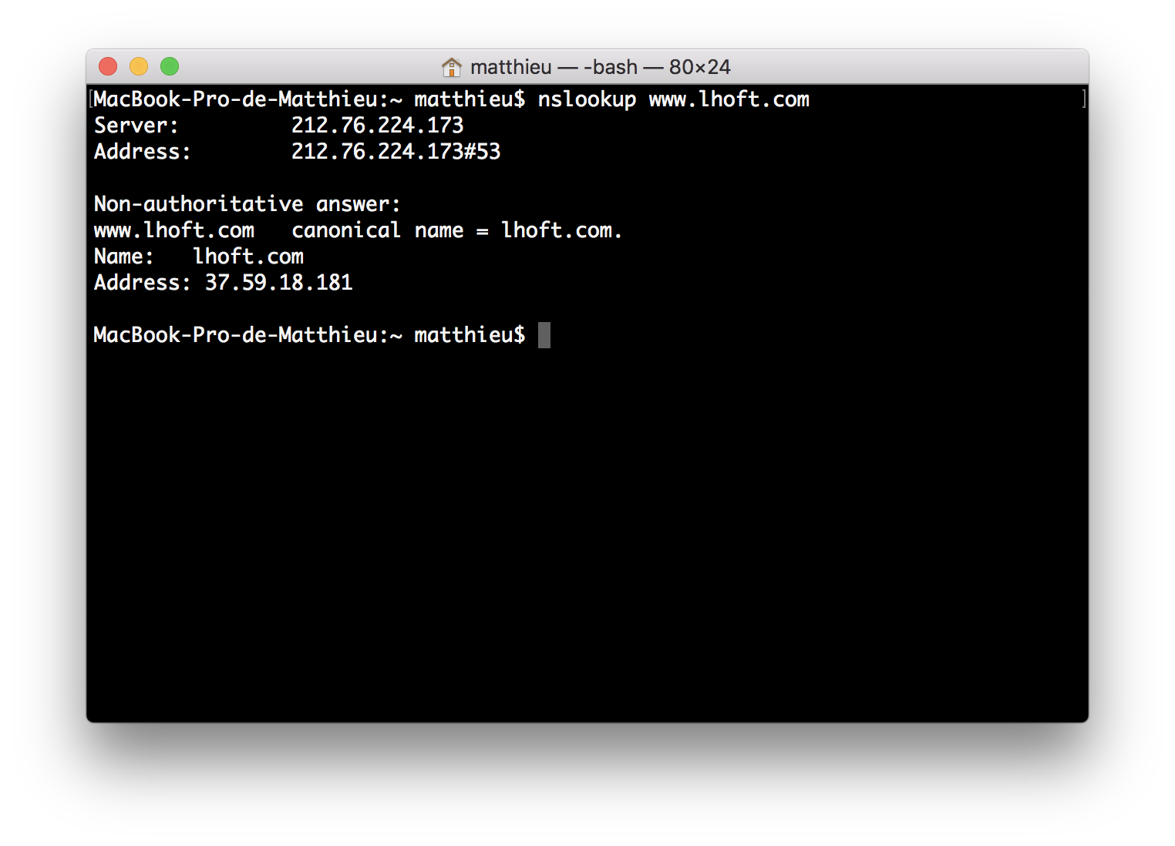
DNS = Domain Name Server
Advanced Network Game – © Securitymadein.lu – M. Farcot – Licensed Under CC BY SA 4.0
Notes:
EXERCISE 2 – Fill list of the IPs on a whiteboard with corresponding names of children (This will be our DNS system). From now on, children can refer to themselves (From field) or the receiver of the message (To field) using an IP address or a name.
DNS search will be the responsibility of router.
11

Slide 12





Ping Game/ Jeu du Ping/ Ping-Spiel
Advanced Network Game – © Securitymadein.lu – M. Farcot – Licensed Under CC BY SA 4.0
PING?
OK!
Notes:
What is a ping command? Allows a computer to see if a target is online or offline.
EXERCISE 3 –take a message (simple paper). Write your IP or DNS (if applicable) in FROM field, the destination in the TO field (IP or DNS), & a PING message. Pass message to router. Router delivers (first do a global game, all children working together). PING target must respond PONG to initial sender
12

Slide 13
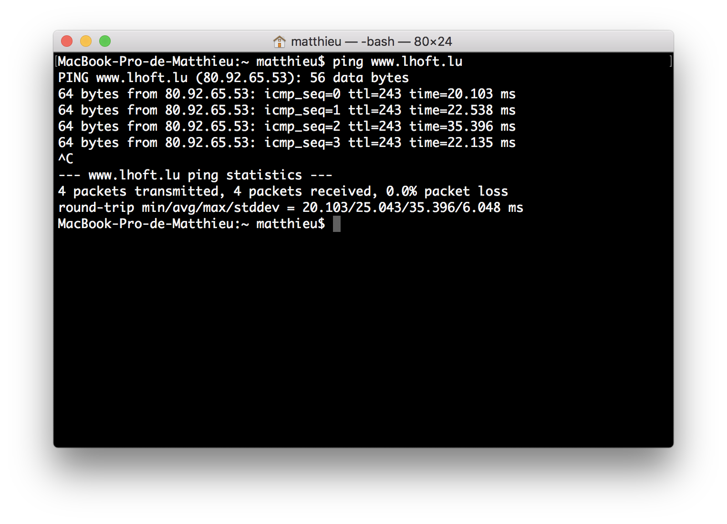
Ping Game/ Jeu du Ping/ Ping-Spiel
Advanced Network Game – © Securitymadein.lu – M. Farcot – Licensed Under CC BY SA 4.0
Notes:
What is a ping command? Allows a computer to see if a target is online or offline.
As you can see, ping is in milli-seconds. Insist on that fact with children.
13

Slide 14
Ping Game/ Jeu du Ping/ Ping-Spiel
Advanced Network Game – © Securitymadein.lu – M. Farcot – Licensed Under CC BY SA 4.0
In Fortnite, low latency (Ping) is essential
Notes:
As you can see, ping is in milli-seconds. Insist on that fact with children.
Give the example of a high ping on a multiplayer game – a high ping gets other players to teleport on other places, and gets the player to miss all his frags.
14

Slide 15
HTTP/HTTPS
Advanced Network Game – © Securitymadein.lu – M. Farcot – Licensed Under CC BY SA 4.0
Notes:
Problem of messages == clear text (like a postcard). Use SSL/TLS is like putting the postcard in an envelope.
15

Slide 16





HTTP/HTTPS
☑
Advanced Network Game – © Securitymadein.lu – M. Farcot – Licensed Under CC BY SA 4.0
☒
Notes:
Problem of messages == clear text (like a postcard). Use SSL/TLS is like putting the postcard in an envelope.
EXERCISE 4 –Children choose if they send encrypted messages or not. Encrypted messages are put in an envelope, with metadata written on the envelope.
16

Slide 17






Spoof Game/ Jeu du Spoof/ Spoof-Spiel
Advanced Network Game – © Securitymadein.lu – M. Farcot – Licensed Under CC BY SA 4.0
Notes:
Now we can SPOOF an address. Just use the address of someone else in FROM field. Easy.
EXERCISE 5 – Include spoofing in packet exchanges.
Attention: Glue on certain messages some post-its (symbolizing a payload/malware). Warn the receiver of post-IT that he should keep it.
17

Slide 18




BotNet
Advanced Network Game – © Securitymadein.lu – M. Farcot – Licensed Under CC BY SA 4.0
Image Credits: AMC
Notes:
Explain that receivers of post-it got a malicious payload that made them zombies within a botnet. Explain that YOU have total control of them. They keep on working normally. But as zombies, they are infected. And they will do what you tell them to when asked to.
18

Slide 19
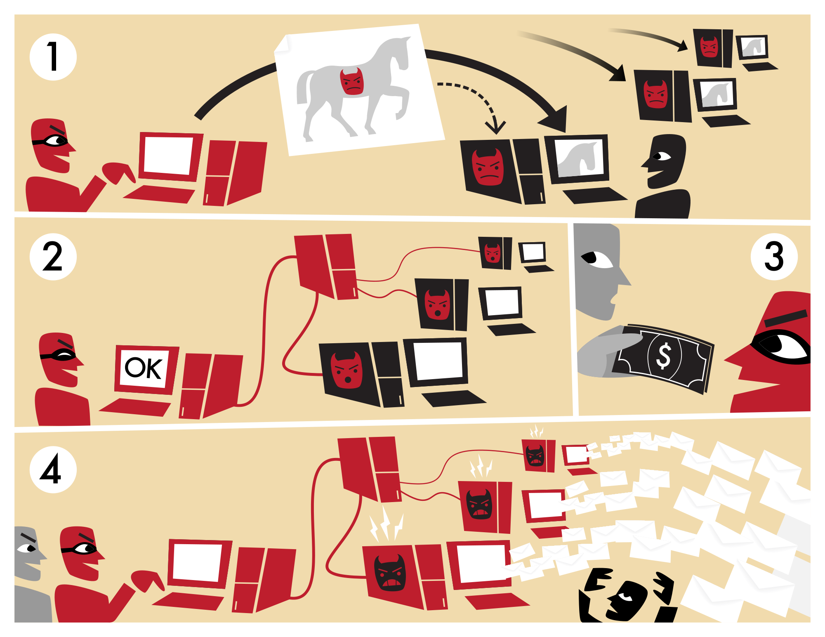
DDOS!
Advanced Network Game – © Securitymadein.lu – M. Farcot – Licensed Under CC BY SA 4.0
Source: wikipedia.org
Notes:
Explain that receivers of post-it got a malicious payload that made them zombies within a botnet. Now ask all zombies to send request to the same IP.
Use example to explain the motives begind a Ddos attack.
EXERCISE 6 & Final - All players play at the same time - Normal game continues, except Botnet members that are required to all ping one child (DDOS target). DDOS is fast on target. Ask DDOS’ed child about his feelings after experience…
19

